Slide 1
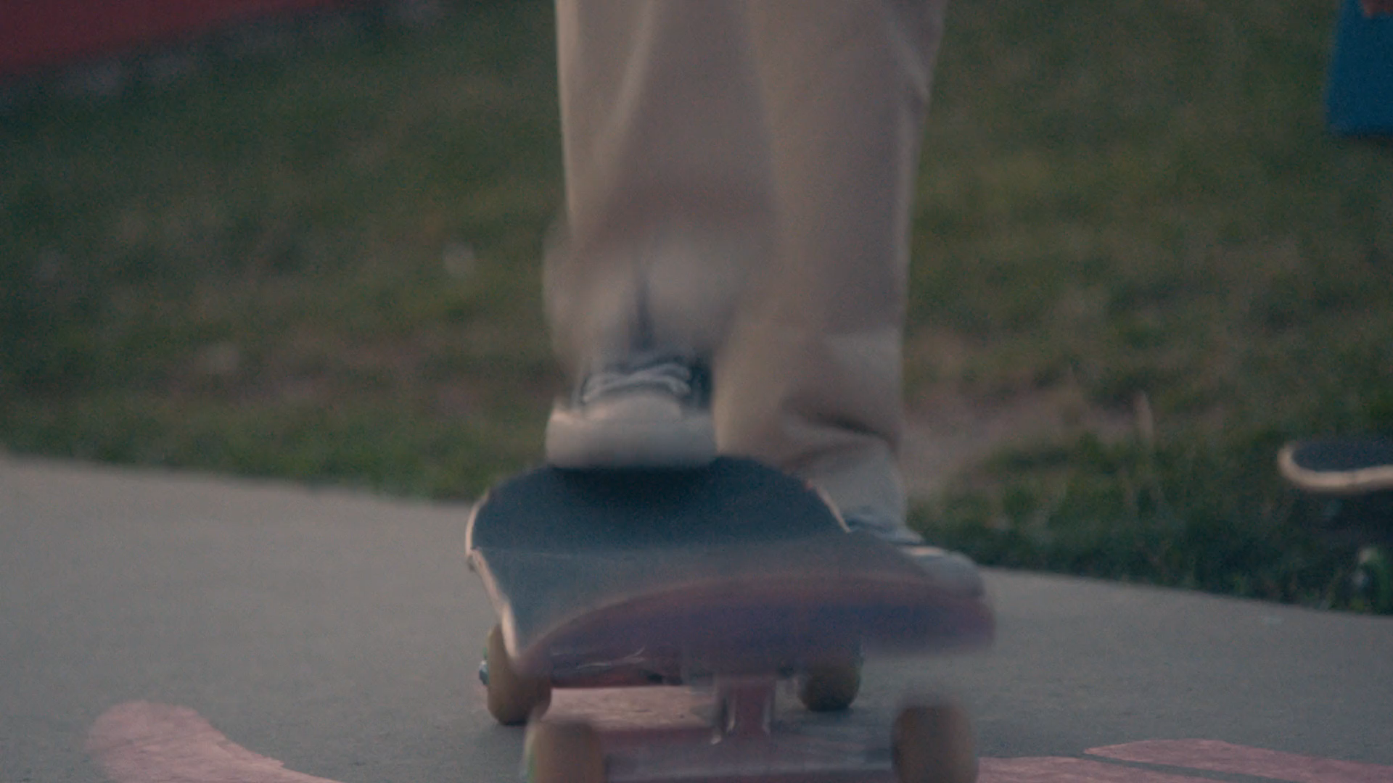
Notes:
A Welcome Clip to signify the Training is starting

Slide 2
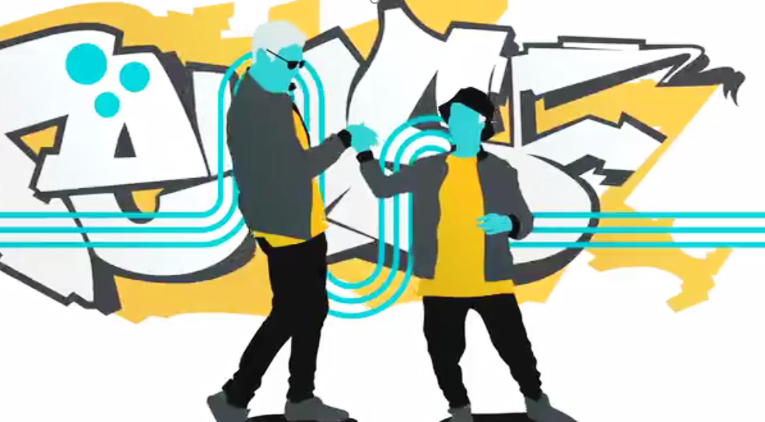
WELCOME TO STRONG FROM THE START CAREGIVER TRAINING
Pre-Match Training
Notes:
Inform the group or trainee that this training is part of their enrollment with Big Brothers Big Sisters.
This training is a mandatory step before matching.
The training can take up to 20minutes or longer if trainers do many of the suggested activities.
The suggested activities are optional.

Slide 3
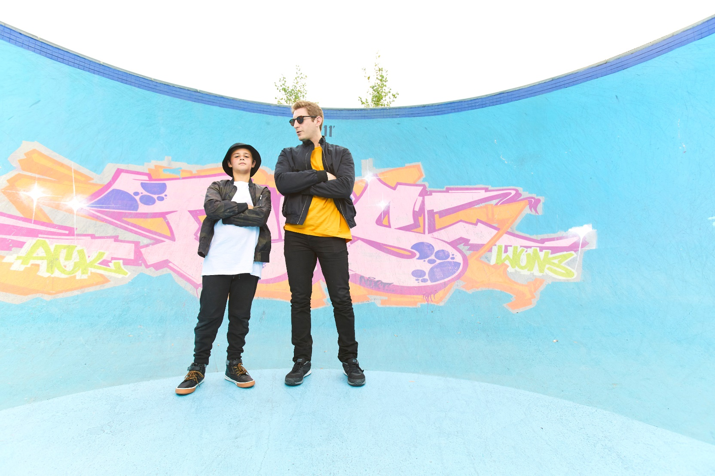
WHY ARE YOU HERE TODAY?
We’re here for you and your child, from the beginning to the end of the match.
Together, we’ll ensure your child has a strong, safe, healthy, and enjoyable match.
© 2020 by Big Brothers Big Sisters of Canada.
Notes:
You want the participants to feel comfortable, confident,
and positive.
Set a tone that encourages and empowers parents/guardians as important match participants.

Slide 4
5 REASONS WE ARE HERE TODAY:
  1. To get to know each other a little bit.
  2. To share a little more information on Big Brothers Big Sisters.
  3. To introduce you to the core topics and key messages we’re sharing with child/youth.
  4. To emphasize the important role you play throughout the match.
  5. To share information on healthy, safe, respectful, and enjoyable mentoring relationships.
Notes:
Why Are We Here Today? Five Reasons!
To get to know each other a little bit.
To share a little more information on Big Brothers Big Sisters.
To introduce you to the core topics and key messages we’re sharing with your son or daughter.
To emphasize the important role you play throughout the match.
To share information on healthy, safe, respectful, and enjoyable mentoring relationship

Slide 5
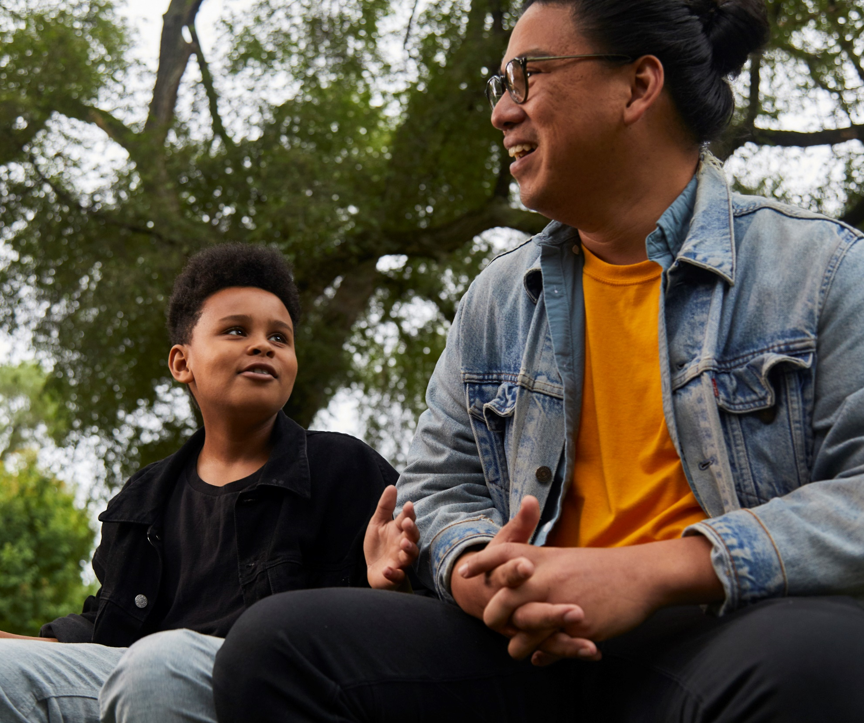
YOU AND BIG BROTHERS BIG SISTERS
You’re making a commitment.
Parents/guardians are essential partners in supporting a strong, healthy match.
© 2020 by Big Brothers Big Sisters of Canada.
Notes:
In this section, you want to solidify that information, and provide perspective on the scope of Big Brothers Big Sisters in Canada.
Your goal is to normalize the experience – many young people join Big Brothers Big Sisters every day.
This is also the time to emphasize to parents/guardians the commitment they are making, the fact that there are match guidelines everyone will need to follow, and the agency's commitment to provide them with the support they need today and throughout the match..

Slide 6
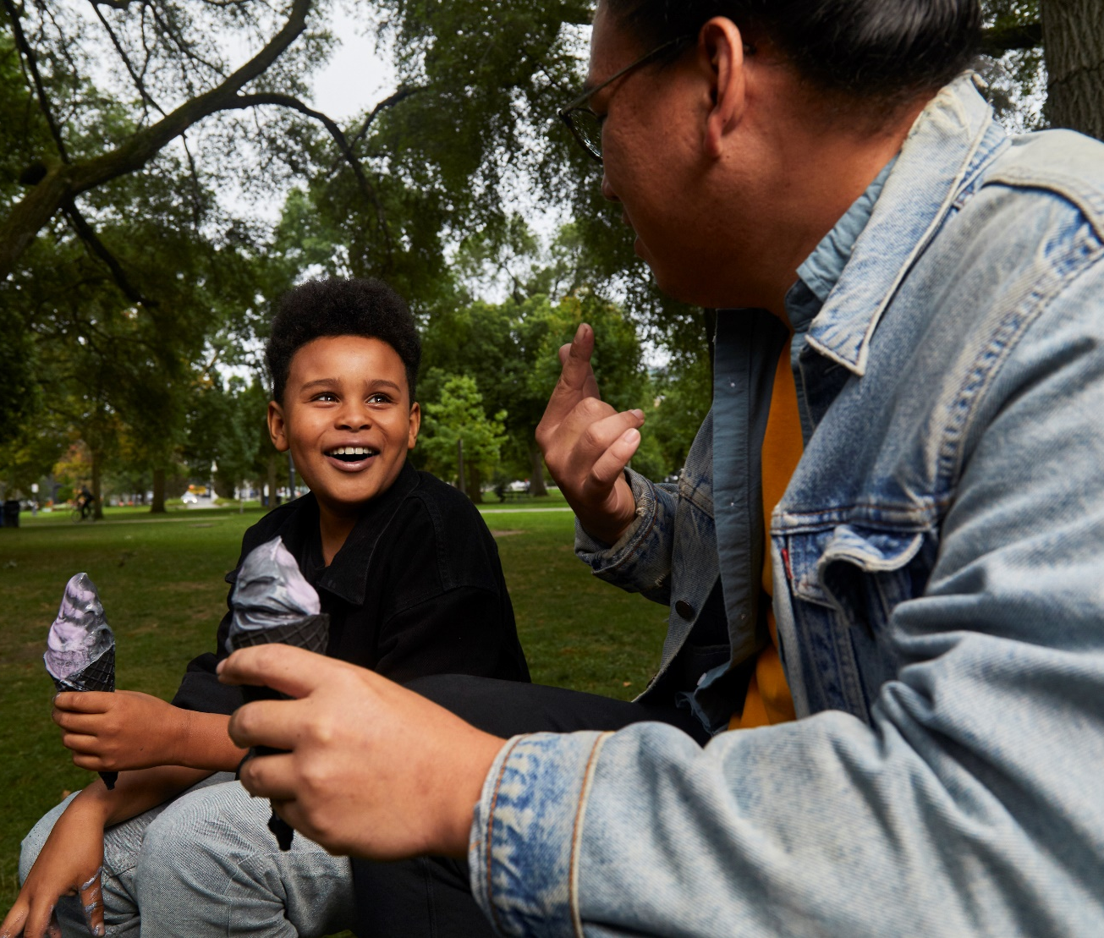
Your Child as a Little / MENTEE
Did you know that over 40,000 young Canadians were mentees last year?
Big Brothers Big Sisters is proud and excited to place a mentor in the life of your child.
Notes:
In choosing Big Brothers Big Sisters, you express caring and encouragement for your son or daughter.
You’re welcoming another positive adult role model in their lives.
Research tells us that children need access to a web of healthy developmental relationships as they grow.
Big Brothers Big Sister is proud and excited to place a mentor in the life of your child.

Slide 7
© 2020 by Big Brothers Big Sisters of Canada.
Notes:
The parents/guardians may have misconceptions about the program, or expectations that may not be reasonable.
Or, they may have a great understanding of what to expect for their child.
This would be a good time to have the parents/guardians share what they think the program will provide.
They can share what they know, and what they hope for, and you can reinforce information and address any misconceptions.
Encourage the parents/guardians to brainstorm what it will mean for their child to be a mentee.
Include some of the things you talk about with the young people:

Slide 8
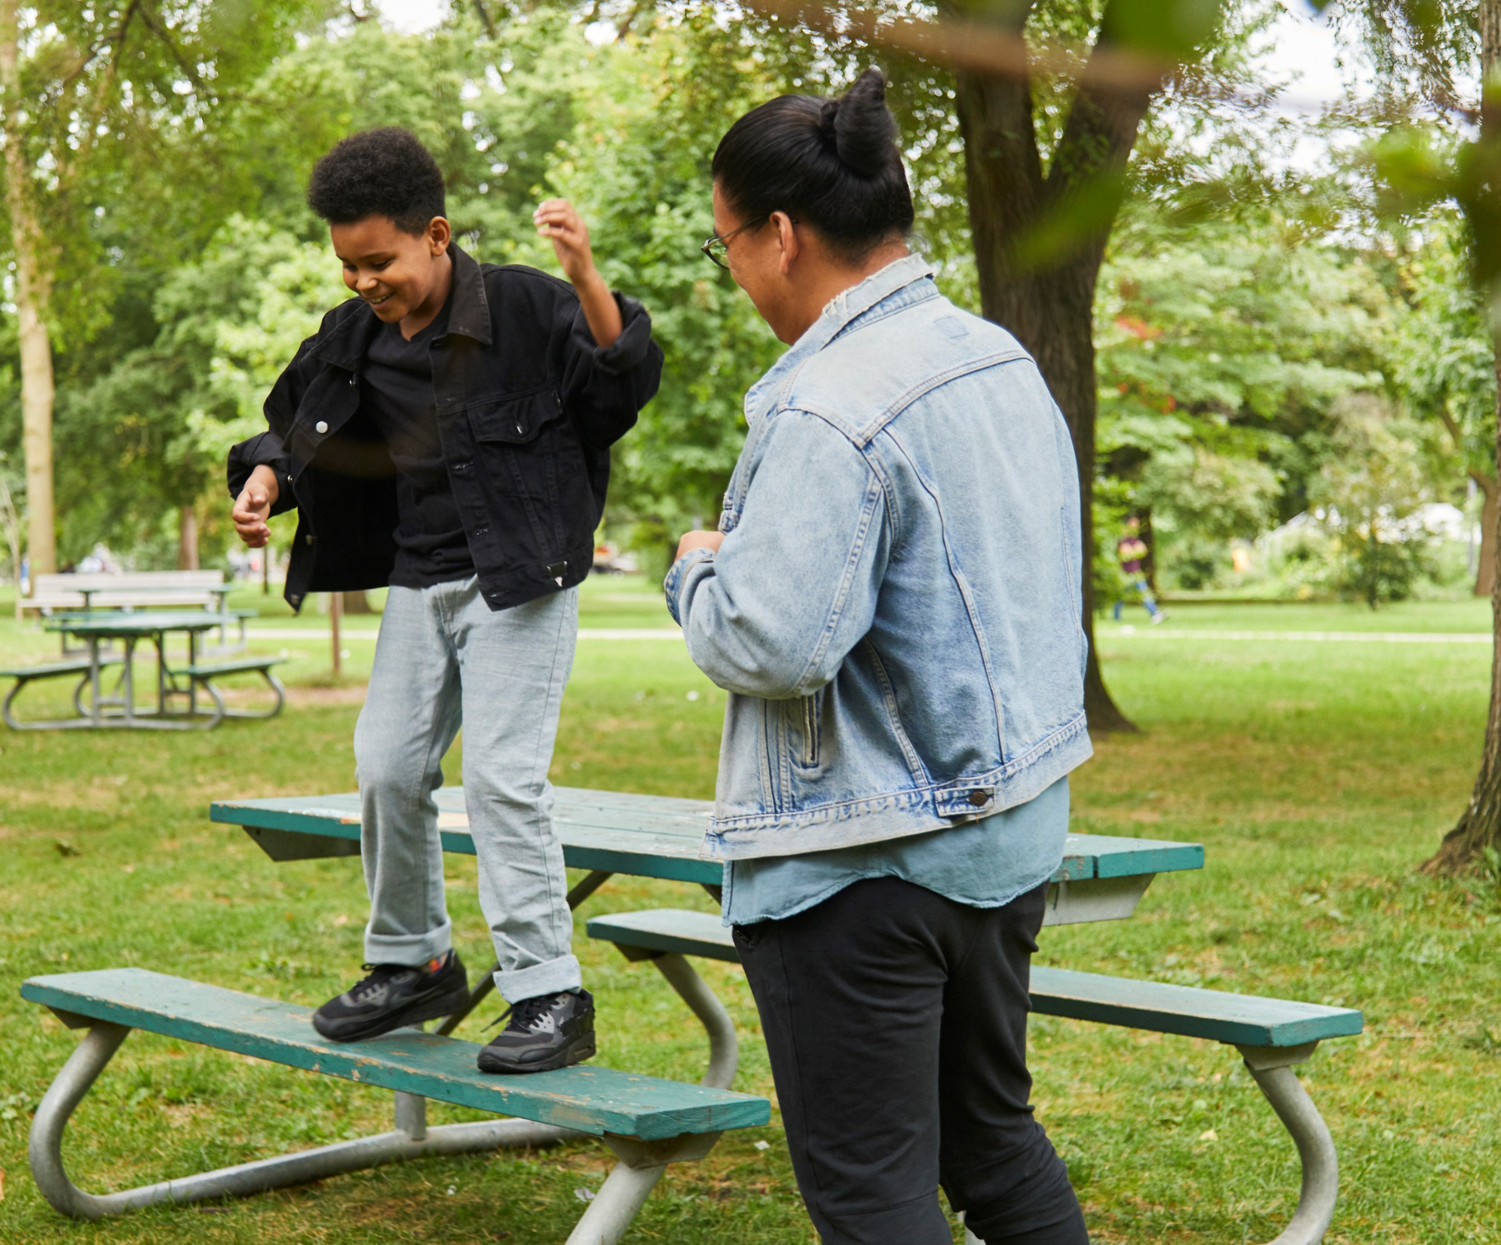
Your Child as a Little / MENTEE
  Your child and their mentor will go on consistent outings.
  It will take a while to develop trust. Give it time.
  It will be a fun, confidence-building experience for your child.
Notes:
Suggested Activity: Encourage the parents/guardians to brainstorm what it will mean for their child to be a mentee.
Include some of the things you talk about with the young people:
They want to have a mentor.
It will take time for them to get to know each other.\
They can always talk to their agency person about their mentor or match.
They’ll have a lot of fun and try new things.
They’ll learn about safe activities they can do with their mentor.
By the end of their match, they’ll have the satisfaction of a strong, mutually rewarding friendship.
They will have your support and involvement throughout the match.

Slide 9
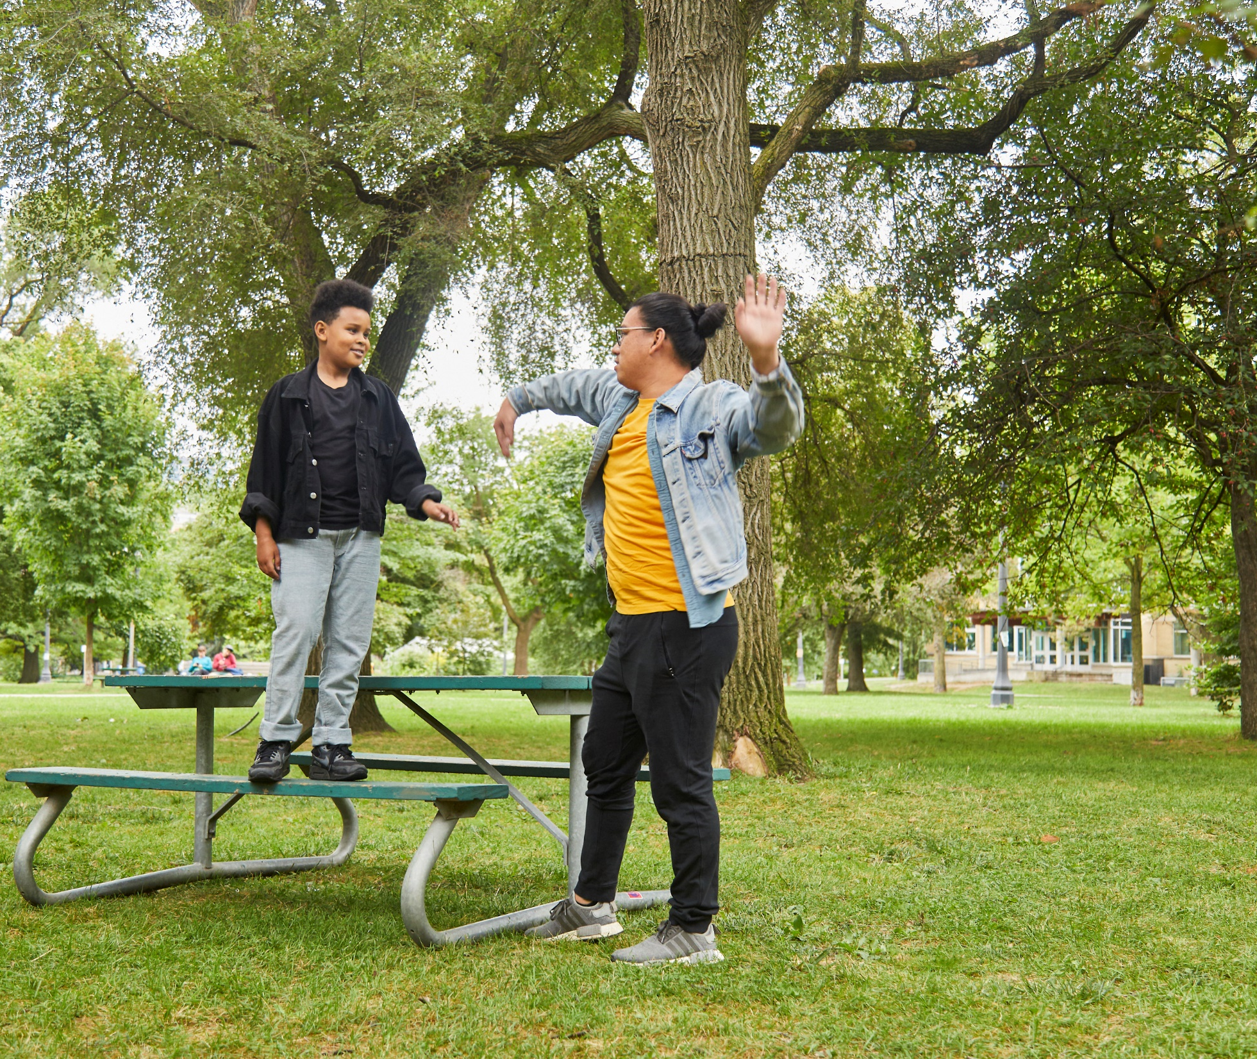
Your Child as a Little / MENTEE
  They will engage in safe and age-appropriate activities.
  Mentors are not substitute parents, babysitters, disciplinarians, financial supporters, a taxi service, or counsellors.
© 2020 by Big Brothers Big Sisters of Canada.
Notes:
Most matches are one-to-one mentoring relationships. Please don’t ask that siblings or friends go along with your son or daughter.

Slide 10


Big Brothers
Big Sisters believes in the
POWER OF 3 3
The Power of:
1. The Child/Family
2. The Mentor
3. The Organization
Notes:
Mentees are the most important people in the match, and they have a team of supporters: you; their mentors; program staff; and, in some site-based programs, a school liaison.
As the parent/guardian, you are an essential member of the match.
In other words, it's important for you to be actively involved. Your program staff will talk with you about the match monitoring schedule.
Sample: during the first year of a community-based match, you (and your child’s mentor) will meet with program staff after four months and after 12 months. You’ll also connect via telephone, or in some cases via email, at approximate monthly intervals at least six times during the first year.
These connections are required in order for the match to continue.
Your program staff will also meet and speak with your child at regular intervals.

Slide 11
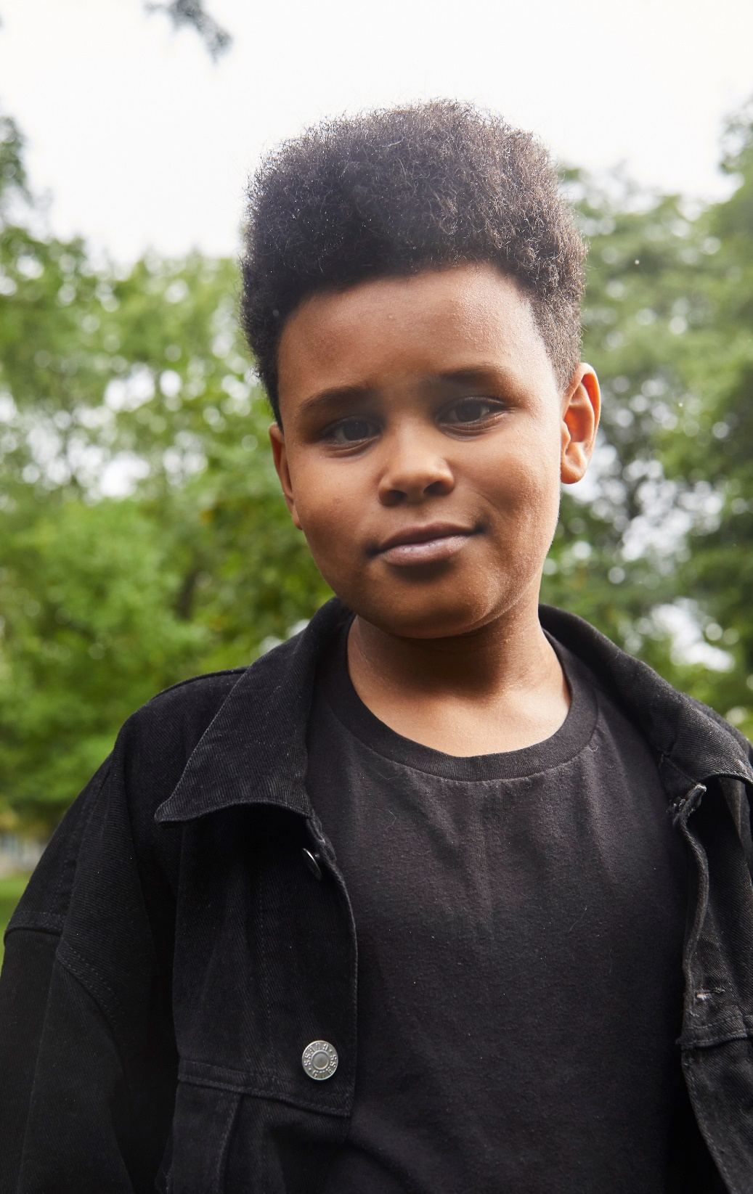
We require your involvement; more importantly, we welcome your involvement!
You can support your child and achieve a true partnership role in their match by staying informed and involved.
If you have any concerns, we want to hear from you. We also want to hear about all the things that are going well!
© 2020 by Search Institute. All rights reserved.
Notes:
Help organize outings and make sure you know the details of all the activities that are planned. When your child comes home from an outing, ask about what they did, and encourage them to share how they felt about the activity.
Another important member of the match team is your program staff.
They will talk and meet with you regularly throughout the match.
In fact, the match will not be able to continue without regular communication.
Suggested group interaction. Ask the parents/guardians to identify roles the program staff could play, and reasons to contact them.
Make sure they include: celebratory reasons, information seeking, concerns, etc. Provide examples from the list that follows:
obtain support to ensure a healthy, successful match;
talk about match activities and accomplishments;
address any questions or concerns you may have;
obtain clarification on program rules;
obtain helpful information, such as resources you may be interested in;
obtain information on agency activities; and/or
chat about effective adult-child communication, etc.

Slide 12
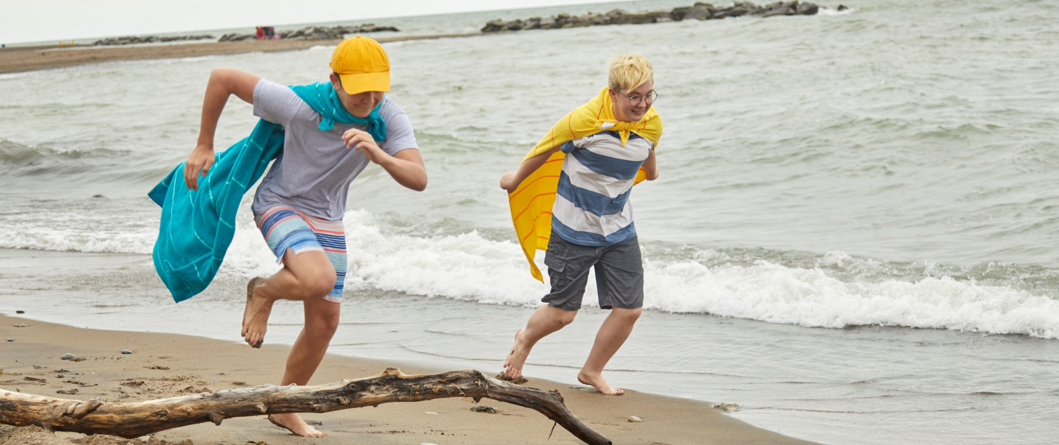
Safe, healthy relationships pave the way for strong, supportive matches.
© 2020 by Big Brothers Big Sisters of Canada.
Notes:
Healthy societies depend on the healthy relationships within them. Respect is at the foundation of healthy relationships.
We explore with the young people the necessary components of a healthy relationship.
We ask them "what makes a good friend?", and we illustrate what a healthy relationship looks, sounds, and feels like.

Slide 13
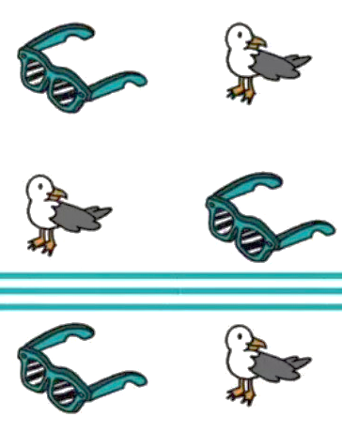
HEALTHY RELATIONSHIPS
When we meet with your child/youth, we explore how young people have a right to be safe and to have healthy relationships. It's an adult’s job to protect children and the young people understand that most adults are happy to play that role.
We talk about the key components of a healthy relationship:
  Safety
  Independence
  Communication
  Trust
Notes:
It is important that the relations between all match participants − mentees, mentors, program staff, and parents/guardians − are healthy.
Healthy relationships facilitate healthy matches.
We’ve been talking about your relationship with program staff; it’s equally important for you to have strong, open, honest communication with your child’s mentor.

Slide 14
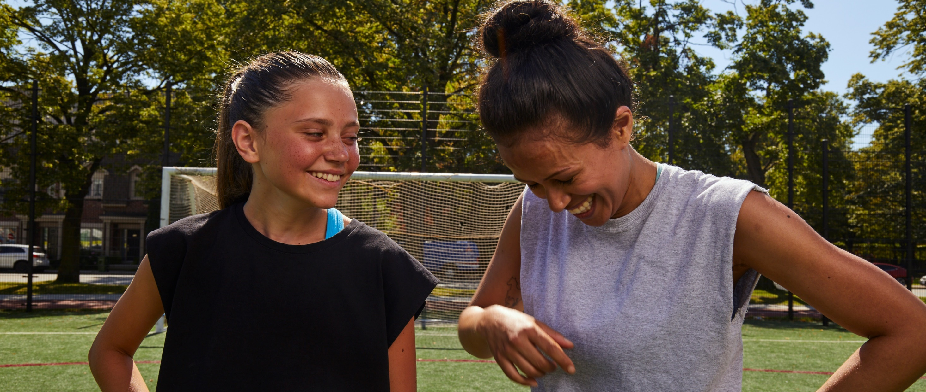
Voices & Choices
© 2020 by Big Brothers Big Sisters of Canada.
Notes:
We talk with the mentees about voice and choice.
With the younger children, we briefly reinforce safety messages the young people learn at school, such as reminding the children that their body belongs to themselves, and no one has the right to do things to them, or make them do things, that are hurtful or uncomfortable.

Slide 15

VOICES & CHOICES
The points below are covered in our mentee pre-match training:
You can trust your instincts.
Healthy relationships thrive on self-respect and respect of others.
Part of respect is showing consideration for each other’s choices and decisions.
Strong, open communication is important.
Big Brothers Big Sisters staff are always available to help or to listen.
Notes:
We remind Mentees, if it doesn’t feel right, it probably isn’t right!

Slide 16
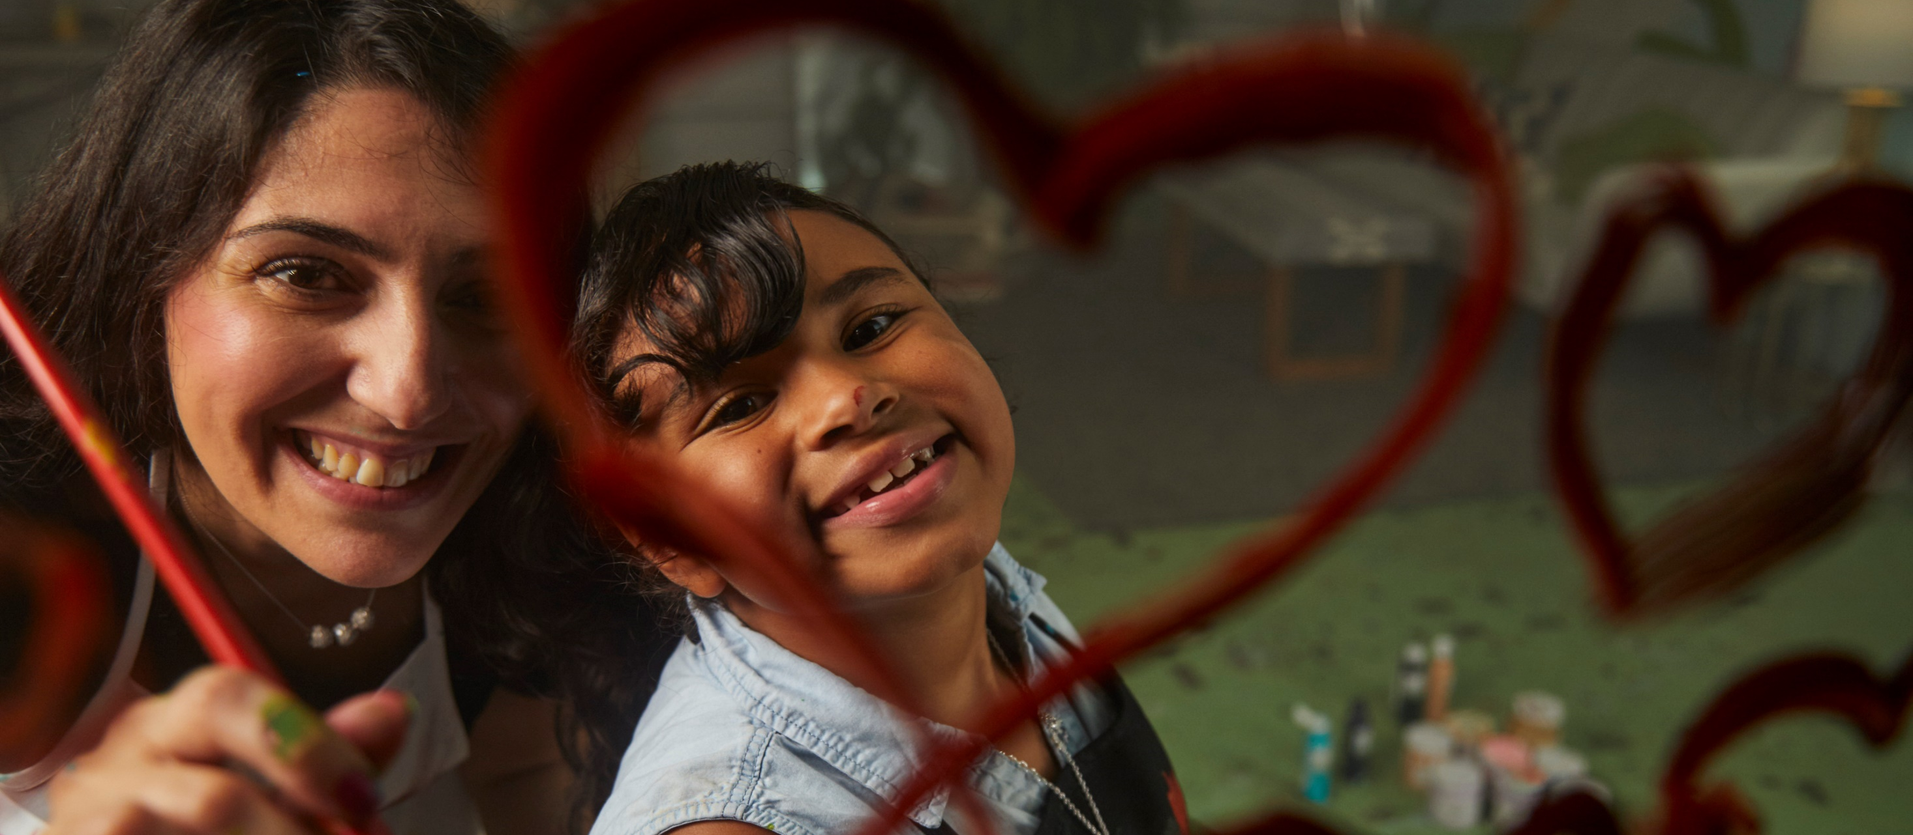
All match participants will set boundaries, which must be respected.
© 2020 by Big Brothers Big Sisters of Canada.
Notes:
In this section we highlight strategies to keep the young people secure and safe in their match.
A core topic – for the young people and for you, the parents/guardians – is boundaries.
You’ll hear us talk about this a lot, and we’re going to ask you about it frequently, throughout the match.
It is the gradual breaking down of boundaries that can lead to unsafe matches.

Slide 17
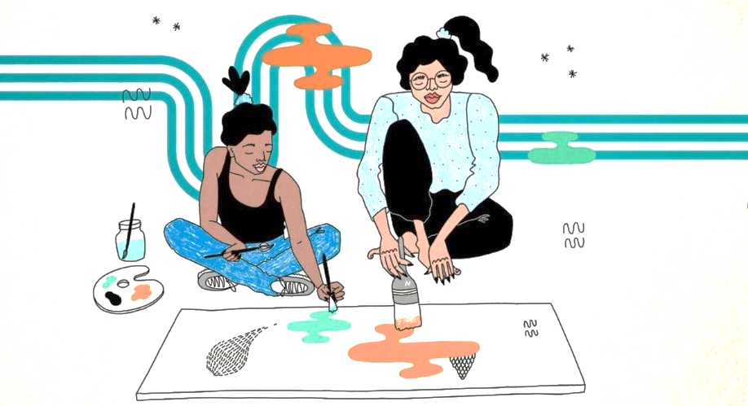
WHAT IS A BOUNDARY?
A boundary is a line that defines something, like the side of a soccer field, the border of our province, or even the edge of a table.
We have personal boundaries, too and we need others to understand and respect our boundaries.
Children who are equipped with an understanding of personal boundaries are less likely to be exploited or victimized. We take the time to clearly define boundaries with your child, and we let them know that it is ok to set match boundaries.
Notes:
Boundaries are critical. This must be well taught and regularly reinforced. It’s important to PREVENT unfortunate situations. While there are critical supports if things happen, our goal is to help ensure they don’t.
Emphasize to the parents/guardians that they'll have regular contact with program staff, and they can turn to them for support when they need it.

Slide 18
EXAMPLES OF BREAKING BOUNDARIES & GROOMING BEHAVIOURS
exhibits seeming over-interest in the child;
gives special privileges, compliments, or gifts to the young person, beyond what seems reasonable;
creates opportunities to be around the young person beyond the context of their work or volunteer environment;
makes false promises;
cites emergencies to justify boundaries being broken
Notes:
In the context of a mentoring relationship, consistently breaking or stretching agency policies is boundary- breaking behaviour, and must be discussed with program staff.
While all match participants may be fully well- intentioned – e.g., “I know we’re/they’re only supposed to see each other once a week but s/he really likes coming to my/my child’s baseball games” – it is critical to remember that rules are there for very good reasons and rarely should exceptions be made.
To further support your child's safety in their match and in their community, we encourage you to reinforce the following points with them:
We all have personal boundaries, and people must understand and respect our boundaries.
Respecting yourself is as important as respecting other people.
Whether you’re talking about a relationship with an adult, a teen or a peer, it’s equally important to set boundaries. Your program staff will be a big help to you in setting boundaries in your match.
If it doesn’t feel right, it probably isn’t right!
Often, if something makes you feel uncomfortable, and then it happens again with the same person, they may go a little further. If you feel uncomfortable, unsafe, unsure, or scared, talk with a trusted adult, such as your program staff or someone in your Circle of Support.

Slide 19
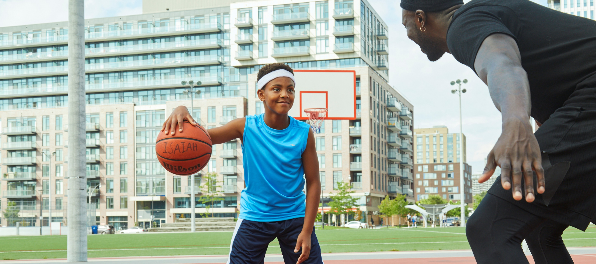
Circle of Support: Foundations for Friendship and Safety
Notes:
At Big Brothers Big Sisters, we talk about a Circle of Support.
We are referring to the adults and teenagers in your child’s life who supports them and wants the best for them.

Slide 20
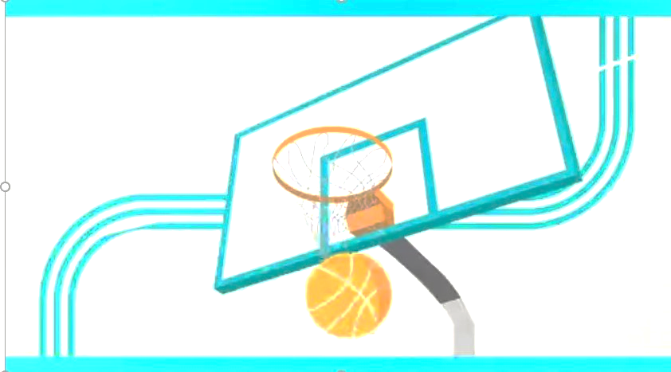
CIRCLE OF SUPPORT
We ask your child/youth to describe their Circle of Support.
The many adults or teenagers in their life who care about them and want them to be safe and happy, and those who will help them if they needed help.
Notes:
At this point in our training with the children and youth, the young people identify a Circle of Support.
The young people place themselves in the middle of the Circle of Support, then bring in people such as family, friends, mentors, and community helpers. Our discussion with the mentees includes:

Slide 21

CIRCLE OF SUPPORT
Your child is in the middle,
then family,
then friends and mentors,
then community helpers.
Notes:
We talk about who these caring adults are and why they are in their Circle of Support.
We encourage you to talk with your child about their Circle of Support.
It will further ensure their safety and happiness in their match, and in their other relationships.

Slide 22

Duty of Care
© 2020 by Big Brothers Big Sisters of Canada.
Notes:
We tell your child that they have the right to be safe and to have healthy relationships.
It's an adult’s job to protect children, and they know that most adults are happy to play that role.
All non-profit organizations, even those staffed by volunteers, have a duty to prevent the maltreatment of children and youth while they are participating in their programs.
The first step to prevention of abuse is to understand what forms it can take. We’re going to talk a little about abuse and disclosure, sharing with you the same information we share with the volunteer mentors.

Slide 23
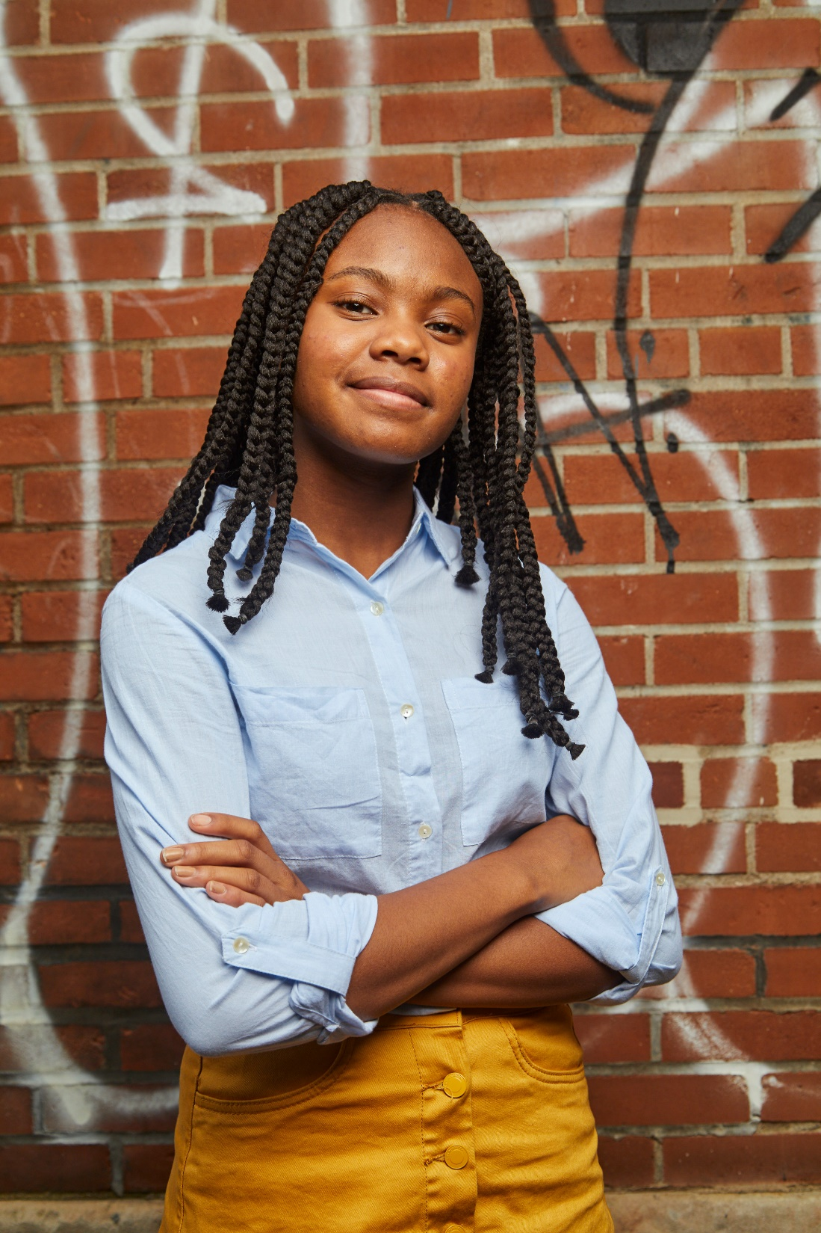
DISCOVERY
when a child/youth reveals abuse through behavior or other external circumstances or indicators
DISCLOSURE
when a child/youth tells you that he or she has been abused
Notes:
Verbal or purposeful disclosures: an individual decides to tell someone about his or her abuse
Non-verbal disclosures: an individual accidentally reveals the maltreatment through behaviour or other external circumstances
It’s not easy for a child to disclose abuse that they’ve suffered, and only a minority of children and youth are able to do it. When they are able to disclose, it’s a process. Most disclosures are delayed, taking the child an average of 3 to 18 years to tell someone what happened to them.

Slide 24
FIVE TYPES OF ABUSE
There are five types of abuse:
EMOTIONAL
SEXUAL
NEGLECT
PHYSICAL
BULLYING
Notes:
Today, we’re going to briefly talk about five types of abuse.
When we have this discussion, think of a tool box.
The details and definitions we’re sharing are tools to help all adults protect young people – your children, my children, all young people.
Together, we can ensure ALL relationships are HEALTHY relationships.

Slide 25
Strong from the Start
People Treating Others with: Coldness Cruelty Extreme inconsistency Ignorance Rejection Isolation | Some Indicators: Depression Withdrawal or aggressiveness Overly compliant Attention seeking Bedwetting Headaches, nausea, abdominal pains Failing to thrive
Emotional Abuse

Slide 26
Strong from the Start
Defined as: Any sexual interaction between an adult and a child, including: Invitation to sexual touch Sexual exploitation of a young person Exposing genitals to a child | Some Indicators: A noticeable fear of touch An unreasonable reaction to touch Unreasonable fear of changing clothing Drawings of a sexual nature Knowledge, games or jokes about sex that are not age-appropriate Abrupt changes in attitude
Sexual Abuse

Slide 27
Strong from the Start
Defined as: Physical- not providing appropriate physical environment (food, clothes, place to sleep) Medical- not providing proper medical attention Educational- legally, children must attend school in Canada Emotional- not providing child with proper emotional support | Some Indicators: Unkempt appearance, poor hygiene Frequent absences from school Clothing that’s inappropriate for the weather Frequently forgetting lunch Unattended physical problems or medical needs Shop lifting (petty theft)
Neglect

Slide 28
Strong from the Start
Defined as: Physical force that causes pain or injury, often resulting in: Bruises Welts Cuts Fractures Burns Internal injuries | Some Indicators: Bruises Welts Cuts Fractures Burns Internal injuries
Physical Abuse

Slide 29
Strong from the Start
Defined as: Bullying is defined as “repeated aggression” in which there is an imbalance of power between the perpetrator and the person being bullied It takes different forms at different ages, including physical, verbal, social, racial, religious, sexual, disability and electronic or cyber bullying | Some Indicators: Depression Withdrawal or aggressiveness Attention seeking or avoiding attention Headaches, nausea, abdominal pains Avoiding social situations such as school Avoiding social media Anxious or fearful behaviours Dislike for their peers, school or people in general
Bullying

Slide 30

Duty of care is a legal concept, and it defines when a person or institution is obligated to protect others from harm.
At Big Brothers Big Sisters, we take our duty of care commitment very seriously.
Notes:
Suggested Quiz:
As a parent/guardian, where can you check the laws regarding child abuse and neglect?
at your Big Brothers Big Sisters agency
provincial legislation
federal legislation
all of the above
2.Who is legally obligated to report abuse or suspected abuse?
social workers, psychologists, and others who work with children and have reasonable grounds for suspicion
only medical professionals who have reasonable grounds for suspicion
any person who has reasonable grounds for suspicion
only a and b
3. By law, you must ensure a report of abuse and/or neglect is made when:
you suspect a child is being abused or neglected
you suspect a child is at risk of being abused or neglected
a colleague/volunteer tells you they suspect a child is being abused or neglected
all of the above (Indicate to parents/guardians that a report must be made; with ‘c’ you must either report the suspicion or ensure the colleague or volunteer has reported the suspicion.)

Slide 31

Ok, that former section was a bit heavy!
Please remember – most child-adult relationships are healthy, fun, empowering.
We need to share the difficult information, so all of us can work together to ensure children and youth in our community are safe and supported.
We are fortunate to support over 40,000 young people – every year – in safe, healthy, resilient, fun mentoring relationships.

Slide 32
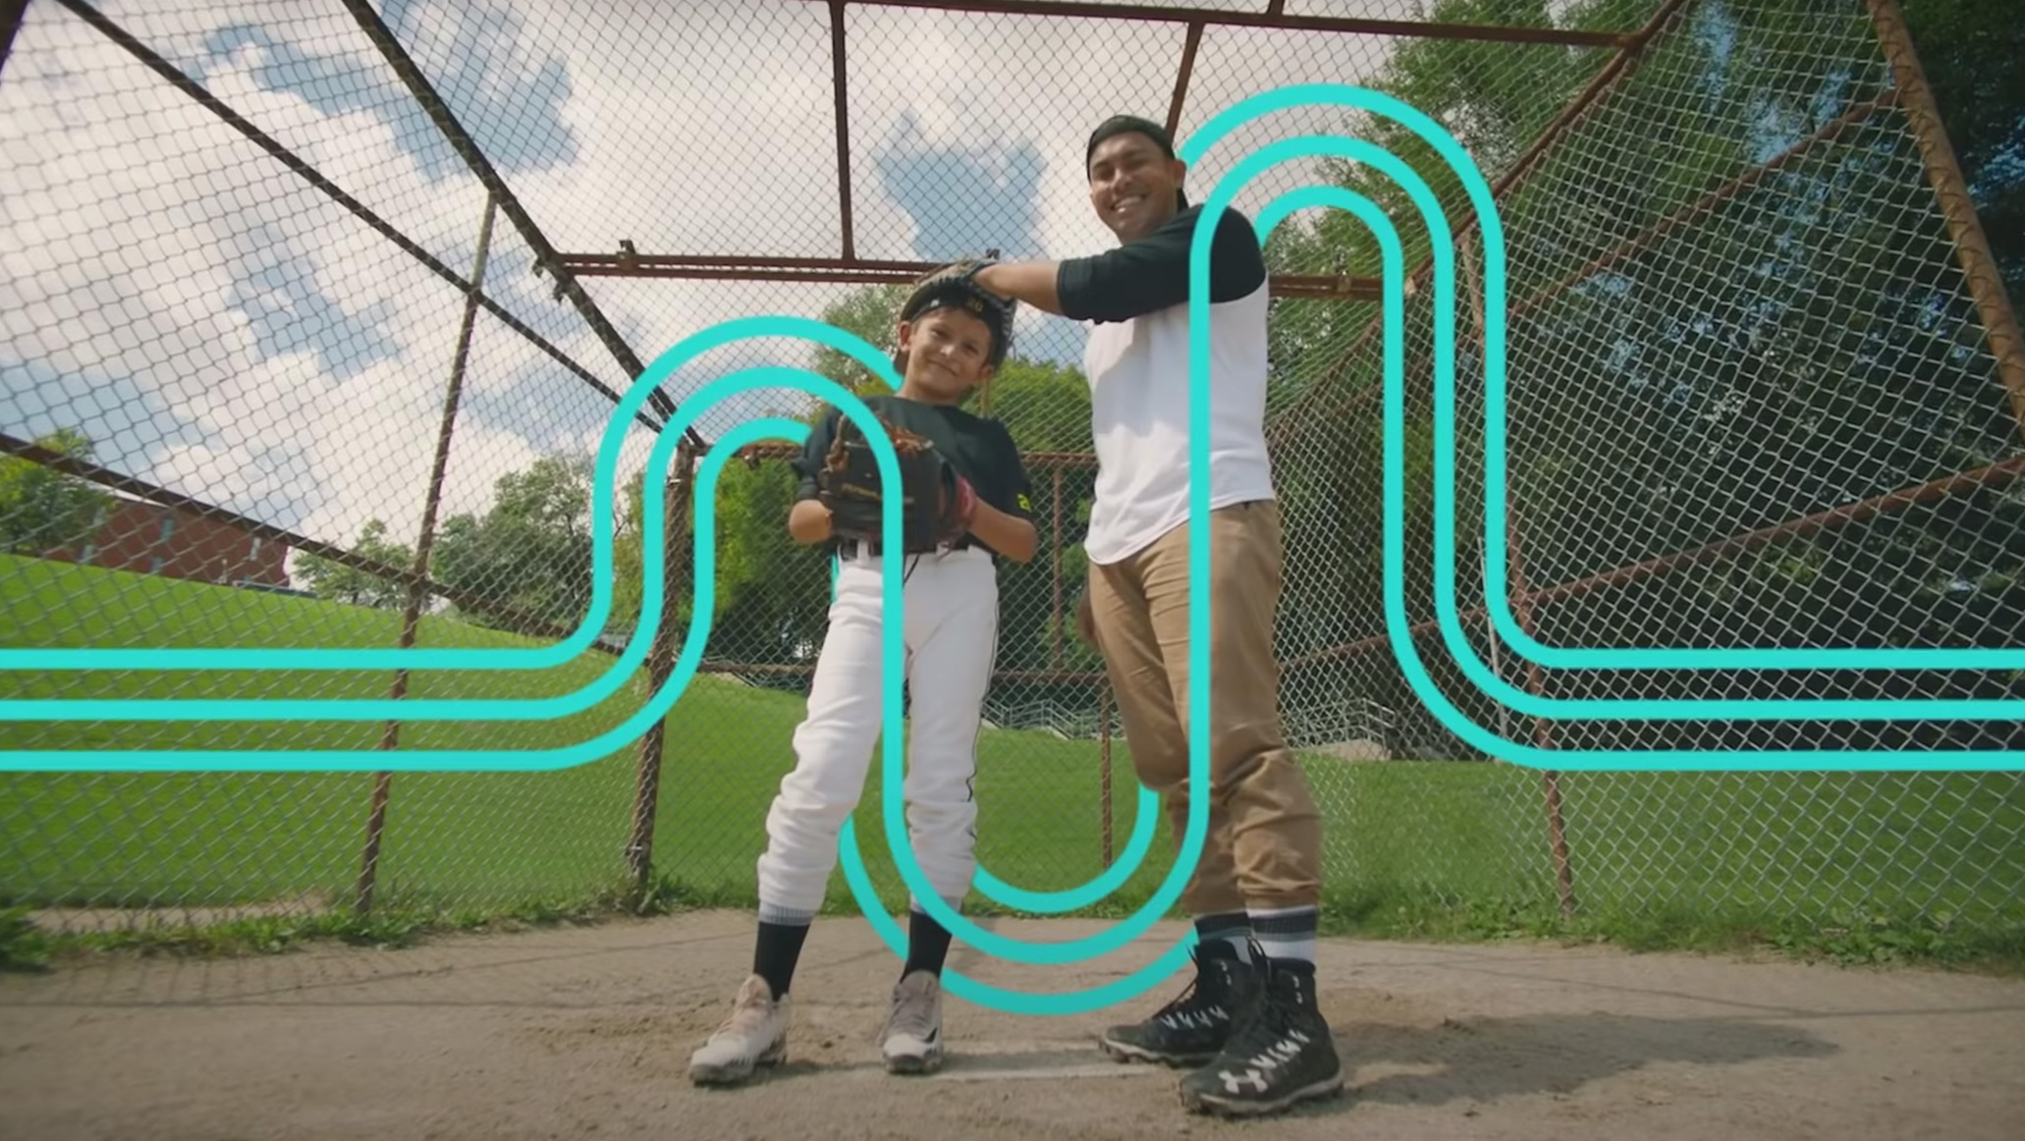
Ready to Start!
Notes:
You’re almost done!
Now it's time to wrap it up well.
Be sure to review the key messages, and end with a fun and positive activity.

Slide 33
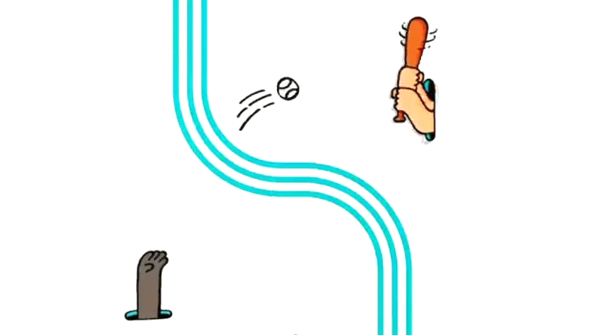
KEEPING IN TOUCH WITH YOU
Your program staff will meet and talk with you on a regular basis.
They’ll also meet and talk with your child/youth and your mentor.
They’ll be getting in touch with you often. You’re also welcome to call, email, or visit them any time!
They want to help ensure you’re
safe, happy, and enjoying your match
Notes:
Activity suggestion, use age-appropriate examples from the list below, state the bullet point and ask the group if it is a Keep or Speak Secret?
Your neighbour offers to give you a gift certificate to your local fast food restaurant if he could take some photographs of you. He says not to tell anyone.
Your friend Jamie is thinking of asking Danny to the dance.
Your friend’s older cousin tickles you when no one is around.
Your teacher asks you and another student to stay after school to plan a surprise party for the class and asks you not to tell anyone.
Your sister is mad at you, so she shares your Facebook password with some of her friends.
Your best friend always pushes Mikky, who is in a younger grade, when they pass each other.
Your drama teacher shares candy with just you, when the group is taking a break, and asks you not to tell.
Your sister says your mom’s boyfriend hurt her and asks you not to tell anyone or she’ll get in big trouble.
Your mom’s boyfriend is planning a surprise birthday dinner for her and asks you to keep it a secret.
Your soccer coach says you’re the best on the team and offers one-to-one practices, as long as you don’t tell your teammates.

Slide 34
WHAT DID WE TALK ABOUT TODAY?
Healthy Relationships
Using your Voice & Choice
Respecting Boundaries
Your Circle of Support
Sharing Secrets
Notes:
Reminder of the topics we reviewed today
Suggested Activity: Ask the group to explain each topic to you, the trainer.

Slide 35

Concludes
Strong from the Start
Caregiver pre-match training
Questions?
Notes:
Provide a light, positive wrap-up and fun ending activity.
Reminder for to Trainers that the Pre-Match Training and Summary of Completion Form must be signed and dated by each caregiver who completes this training.
Completing documentation that proves the volunteer completed PMT Strong from the Start Training is a Standard-N1.

